Slide 1
Simio API MQTT Interfacing

Slide 2
Simio API
MQTT Interfacing

Slide 3
MQTT Background
MQTT (Message Queueing Telemetry Transport) is a lightweight Publish and Subscribe protocol that is used for IoT (Internet of Things) communications.
Communications conversations each have a unique Topic that is hierarchical and formatted using slashes. A packet information conveyed about a Topic is called a Payload.

Slide 4
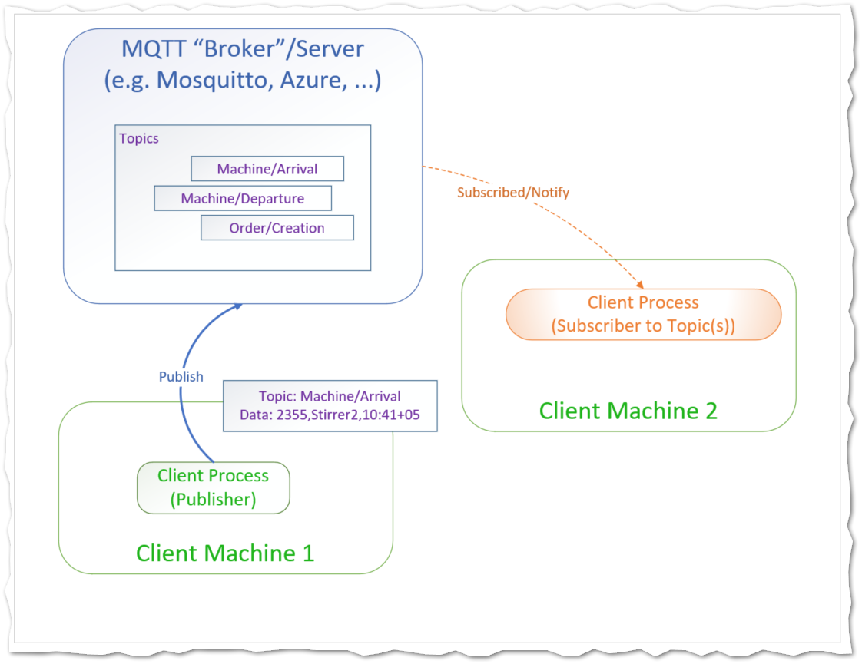
MQTT

Slide 5
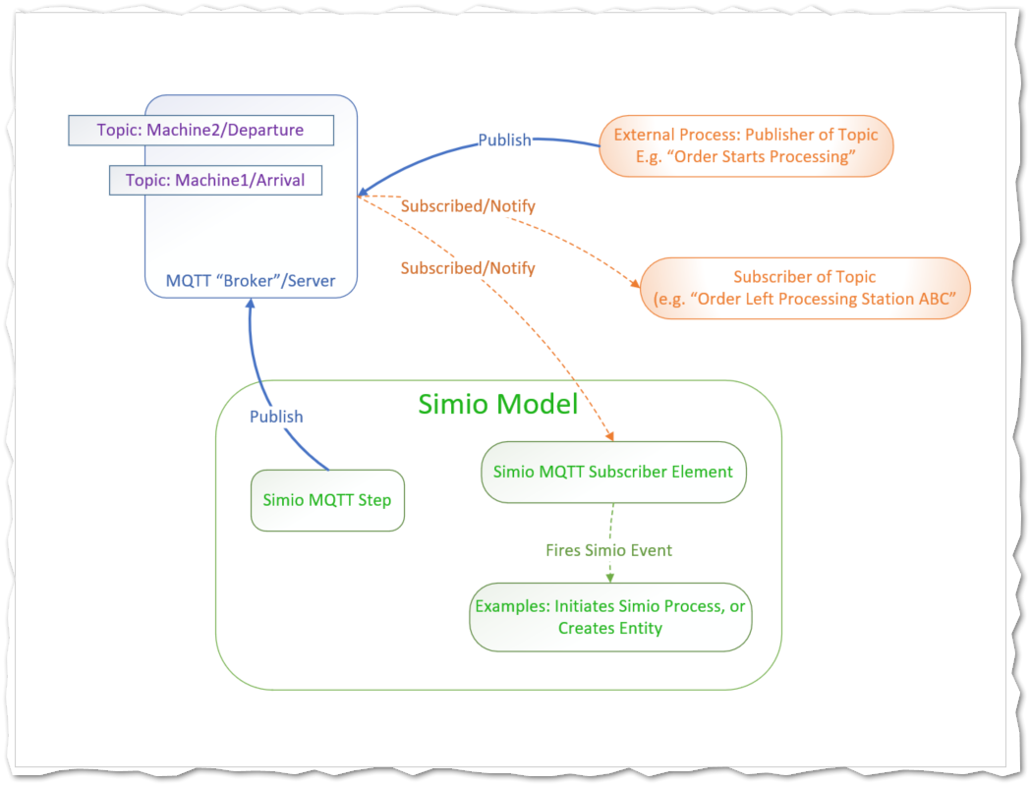
MQTT

Slide 6
Meeting Purpose
Missing pieces for MVP
Installation
Setup (model maintenance and distribution)
Runtime (operator)
Timeframe
ABB is out front
What does Sales and Marketing require?
Notes:
Developers know where we are going
Sales/Marketing need to know what can be done
Try to stay focused on portal, but it interacts with everything

Slide 7
Components
Devops
Support (Liz)
Documentation
Training
Testing
Functional Leads

Slide 8
Support
How
Distribution of Results
Distributed Experiment Runner
Notes:
Project Repository includes hierarchical database-driven storage of Scenarios, Plans, Experiments, and Published results.
Users have Groups, Roles, and Traits to closely refine access to data
The Portal provides a better platform for Production Integration.
Users have tailored abilities to Edit, Upload, Run, and Publish. Dashboards and Gantts can be seen across the Enterprise.

Slide 9
Documentation
Existing Resources
Website Help
Training Videos
Help (Caleb/Alex)
Notes:
Condensing fact from the vapor of a nuance.

Slide 10
Licensing
Caleb, Sarah
Which model(s) are supported?

Slide 11
Training
Coordinator (Caleb)
General Training/OLL (Alex)
LMS options

Slide 12
Sales Support
Adam
MTE, Demos, Webinars

Slide 13
Some Portal Features
Extends Simio to Enterprise
Industry 4.0 Production Integration
Web based, multiple Browsers
Same Simio Engines as Desktop
Public / Private (hybrid) Cloud
Integrates with Simio Desktop
Notes:
Allows Simio to coordinates across the enterprise. Models can be used, shared, and visualized among all corporate employees. An important (the most important?) component of Factory 4.0.
Web based; deploys to IIS, either on dedicated server or VM, either in the Cloud or on-prem. Supports top browsers: Chrome, Firefox, Edge, etc.
Can use the same engines because of Simo’s continuing move to .NET Core, which is allow Simio to support more platforms
For Cloud, it is currently Azure, but Simio’s roadmap includes investigating multi-cloud initiatives, such as CloudFoundry.org

Slide 14
Planning Opportunities /Gaps
Platforms
Features
Performance / Scalability
UI
Modeling Features
Security
Interfacing (Data In/Out)
Setup cost (model construction, …)
Release Cadence
Notes:
Platforms. Currently Windows / Azure. Extend to Linux, AWS, ?

Slide 15
What Next?

